Slide 1
Quantitative Breakdown of Passing in the NBA
Aaron Foote

Slide 2
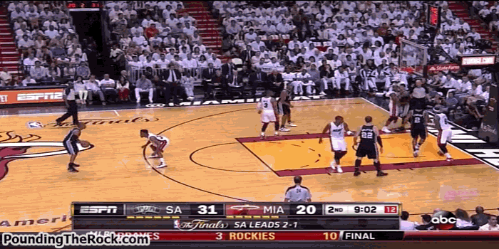
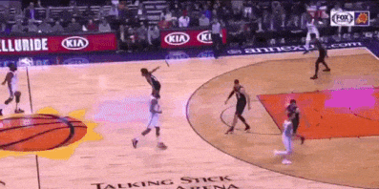

Slide 3
Goals
Quantify!
Underlying patterns
Outliers

Slide 4
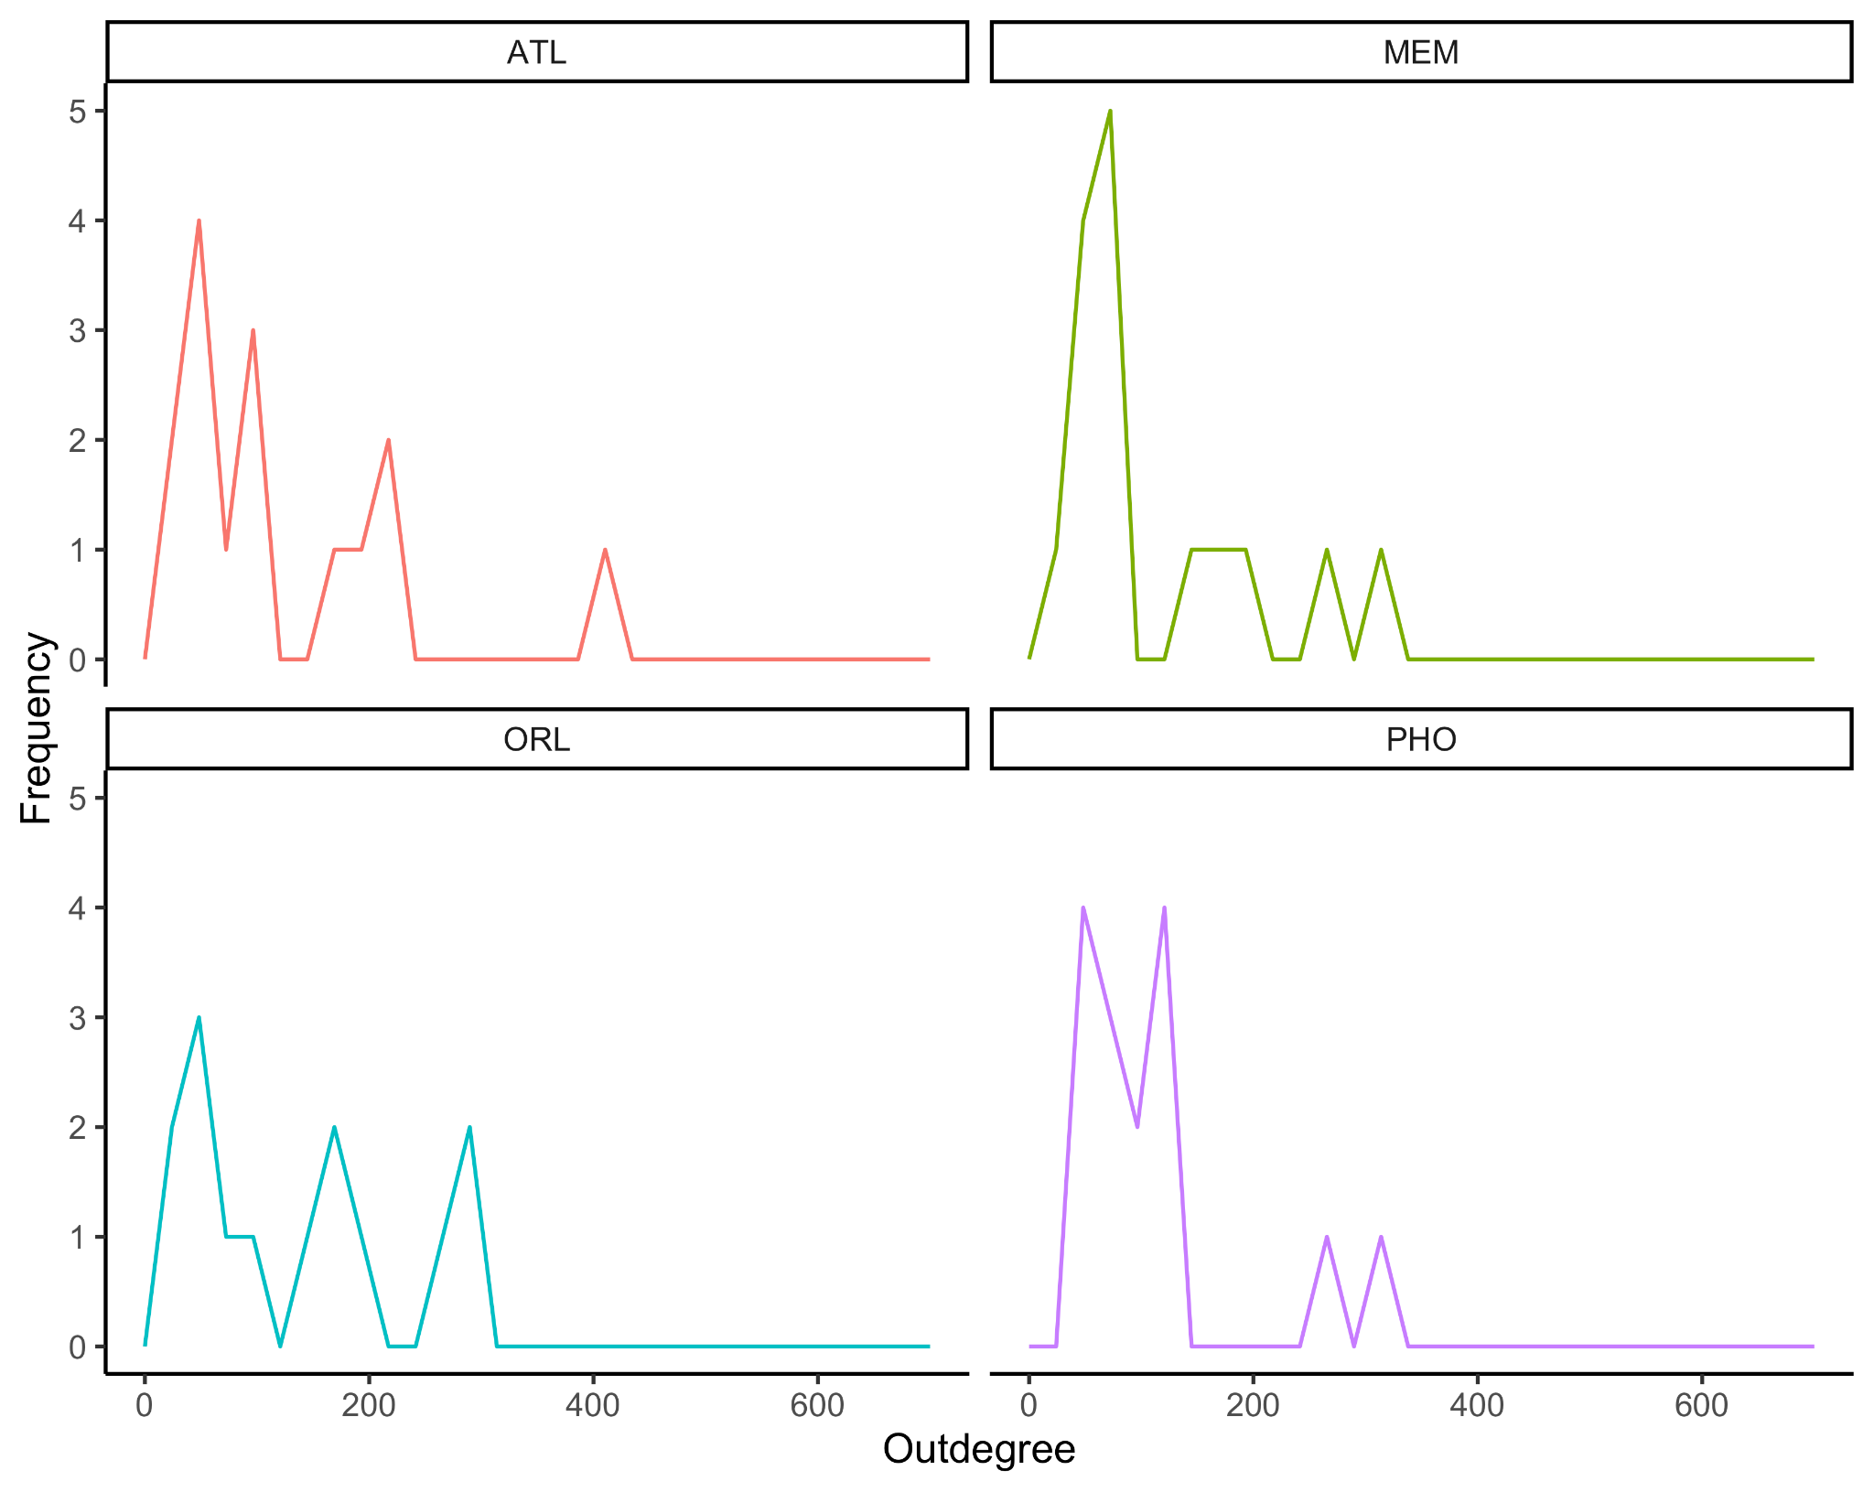
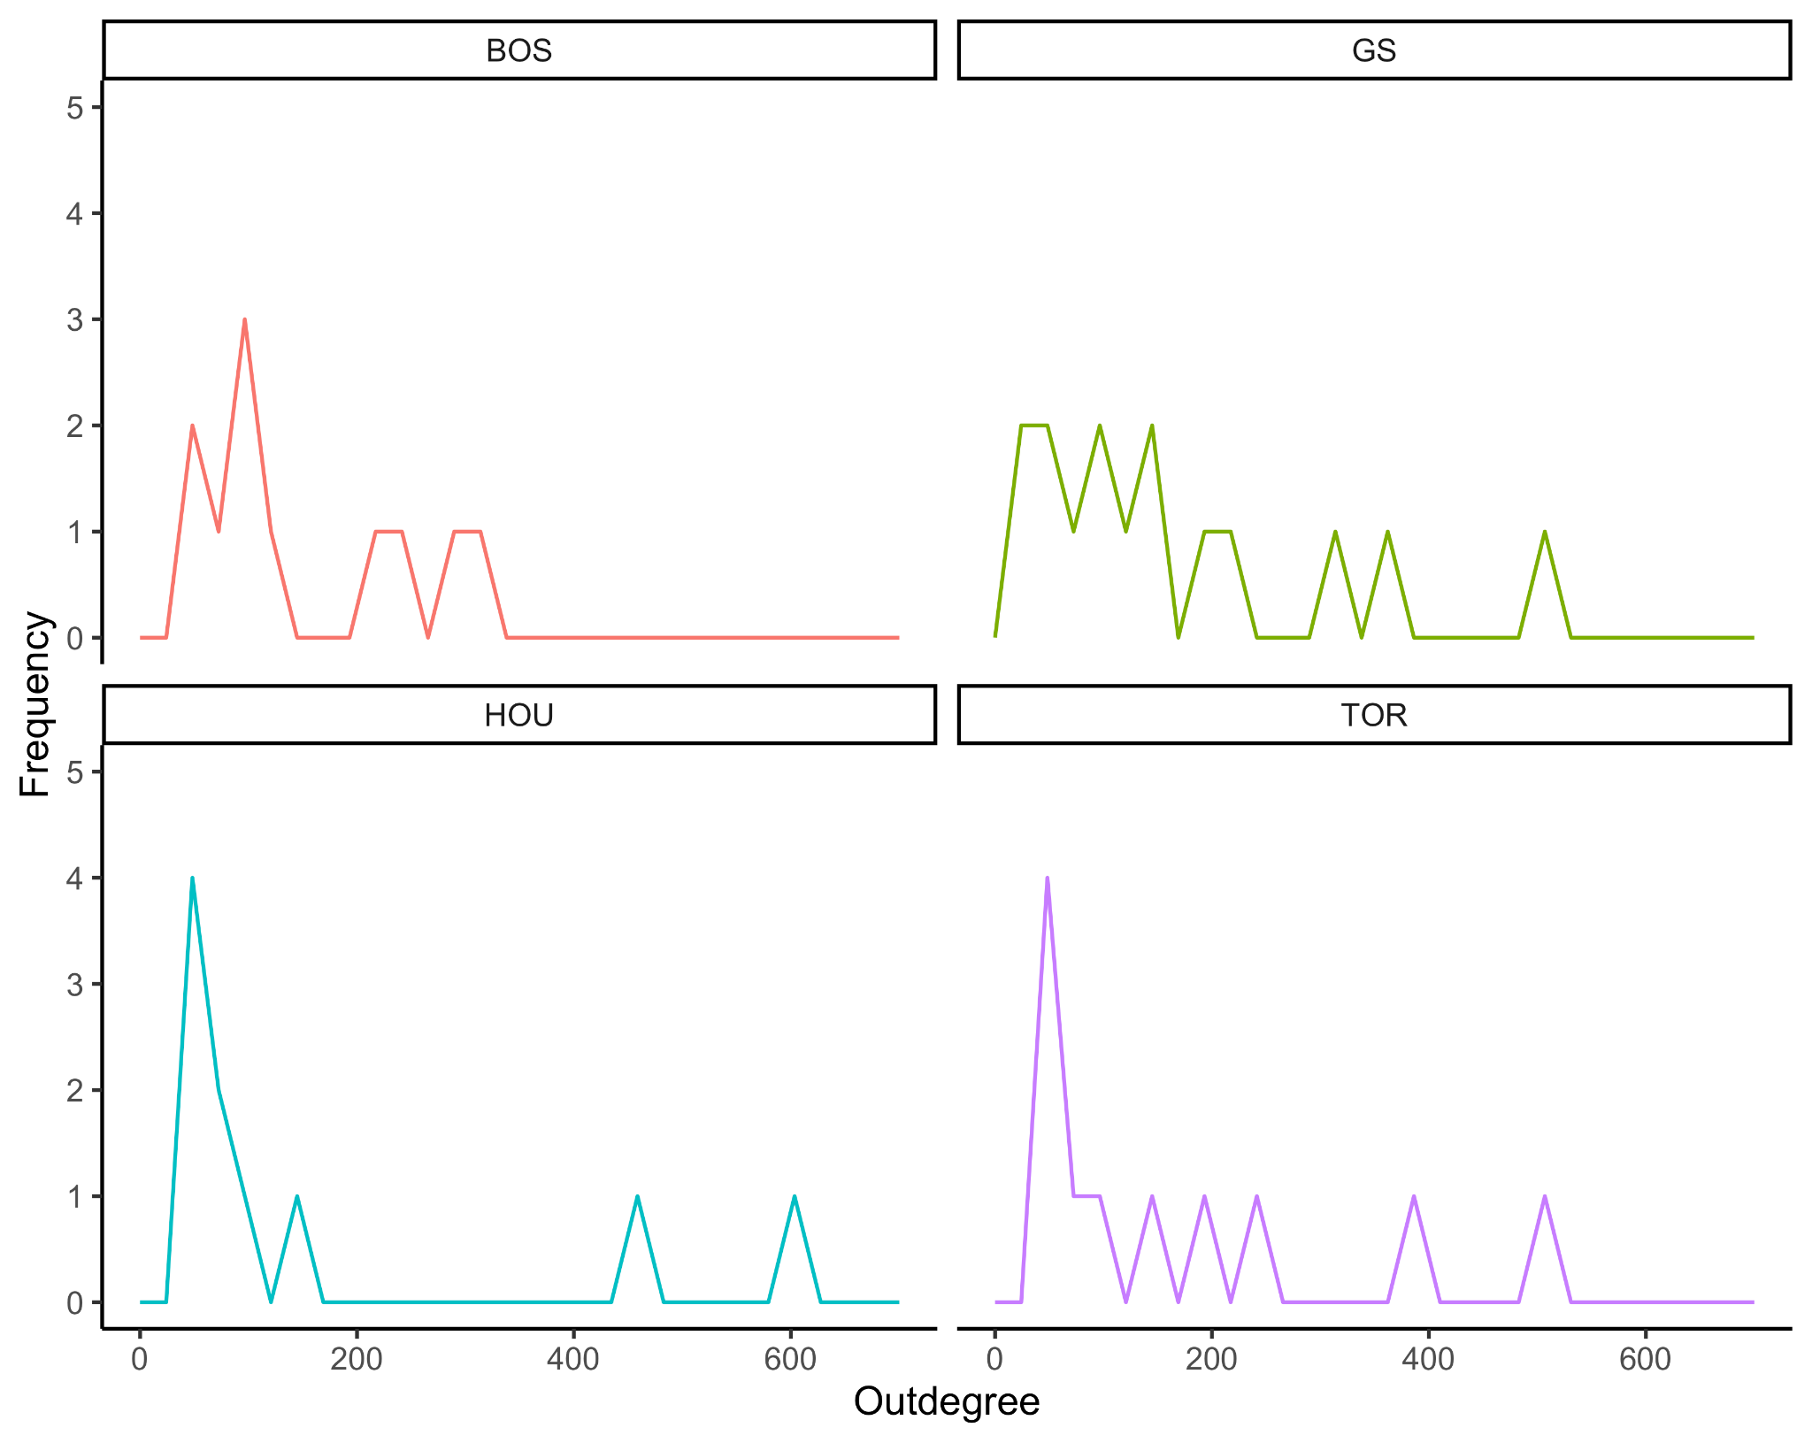
Outdegree: Assists a player initiates
Notes:
Go over indegree vs. outdegree
These plots are the distributions of players and their indegree/outdegree
These are the winning teams
Not very many points because not many players make a significant contribution to a team (tons of 1-5s)

Slide 5
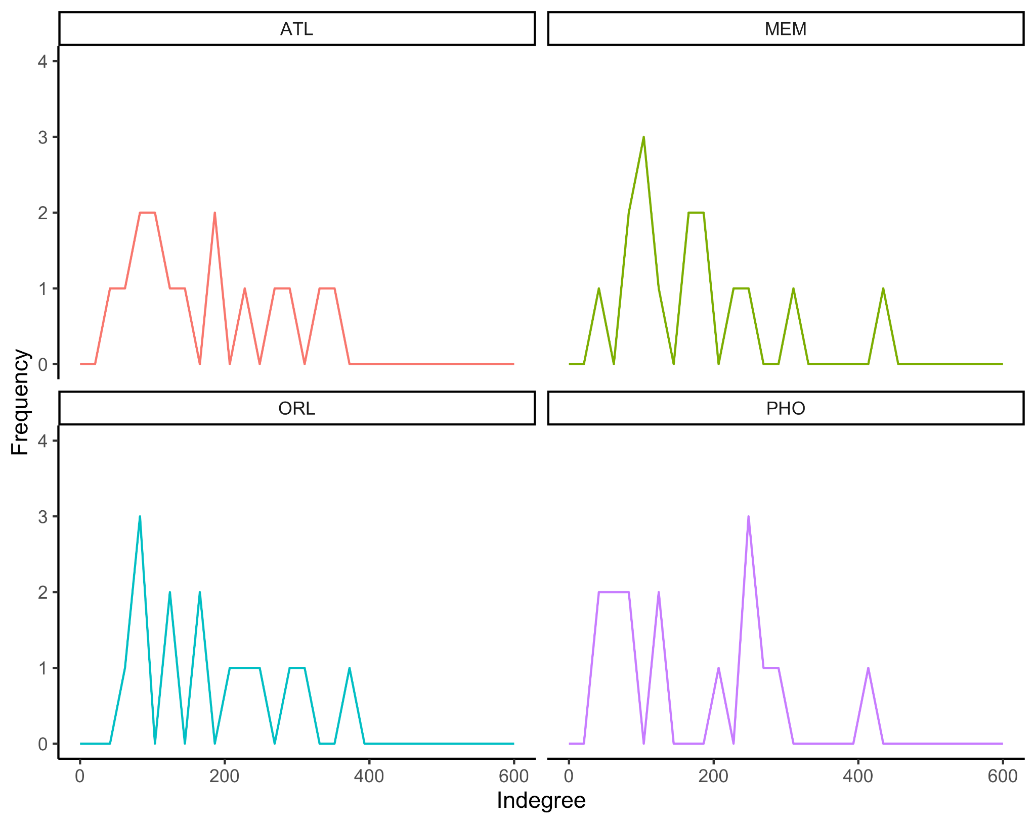
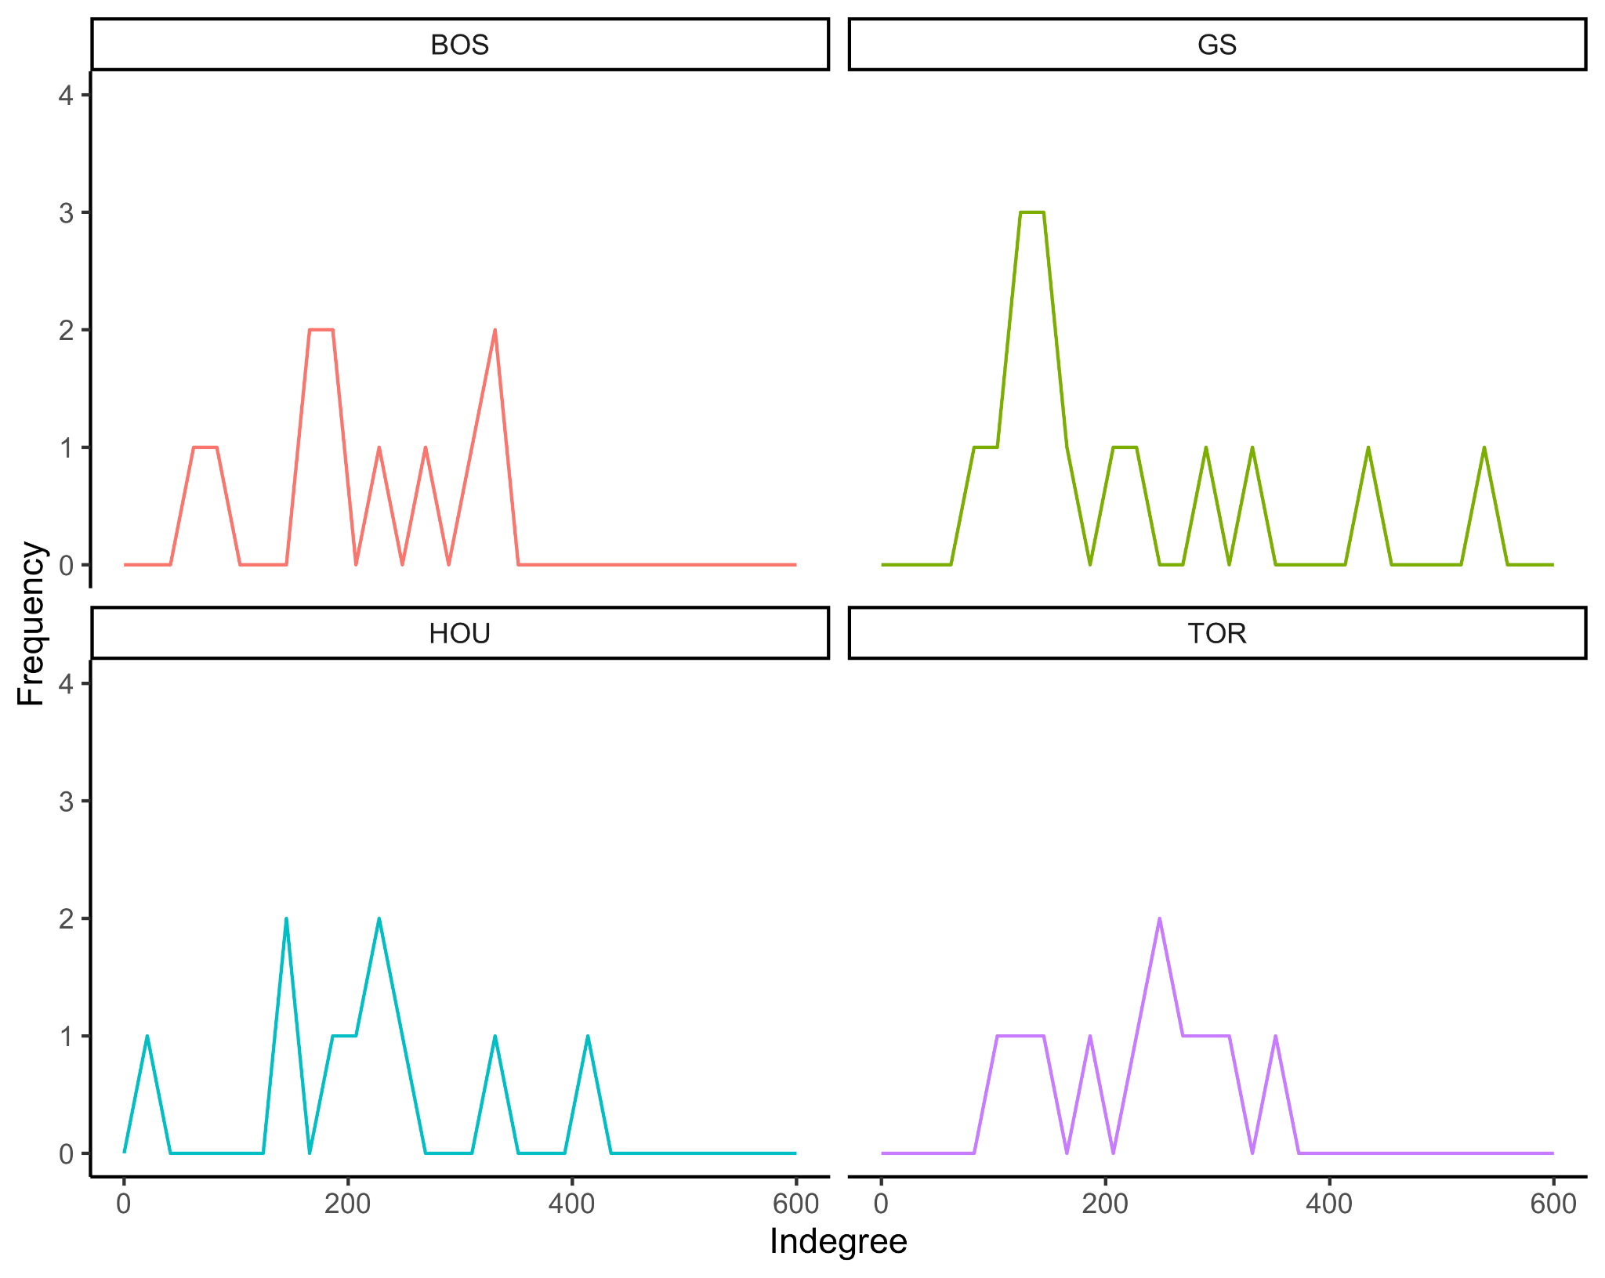
Indegree: Assists a player receives
Notes:
How many assists a player receives
You can SEE the difference in distribution of scoring on assisted plays from the winning teams and the losing ones
For Houston, they peak early but that’s role players, look at the little hump on the end (Harden)
I would translate this to a team not having a leader/ball dominant player that can control the offense (more on that later)
This only focuses on one end of the court, whle phoenix was doing some good things on the offensive end, they were the worst defensive team in the NBA in terms of points allowed that season, making a lot of what they did on the offensive end irrelevant

Slide 6
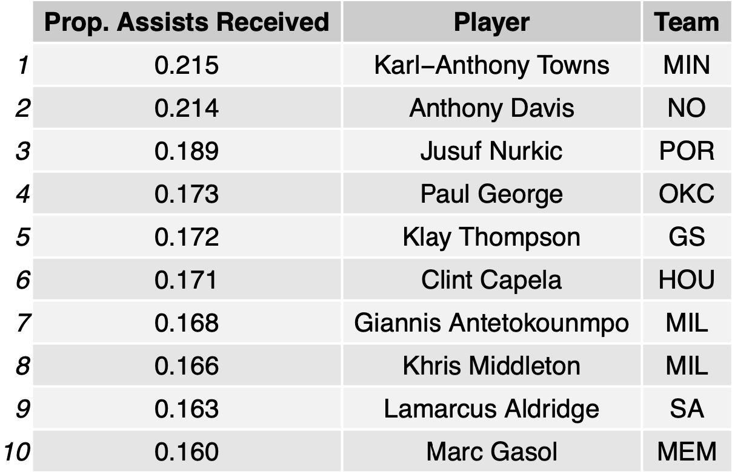
Proportion of Team Assists Received
Style of player
Common comparable stat
Usage Rate (USG%)

Slide 7
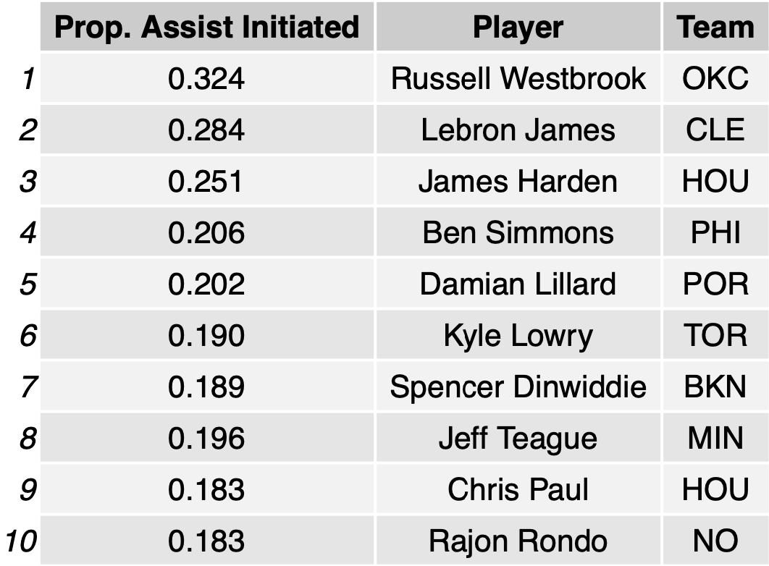
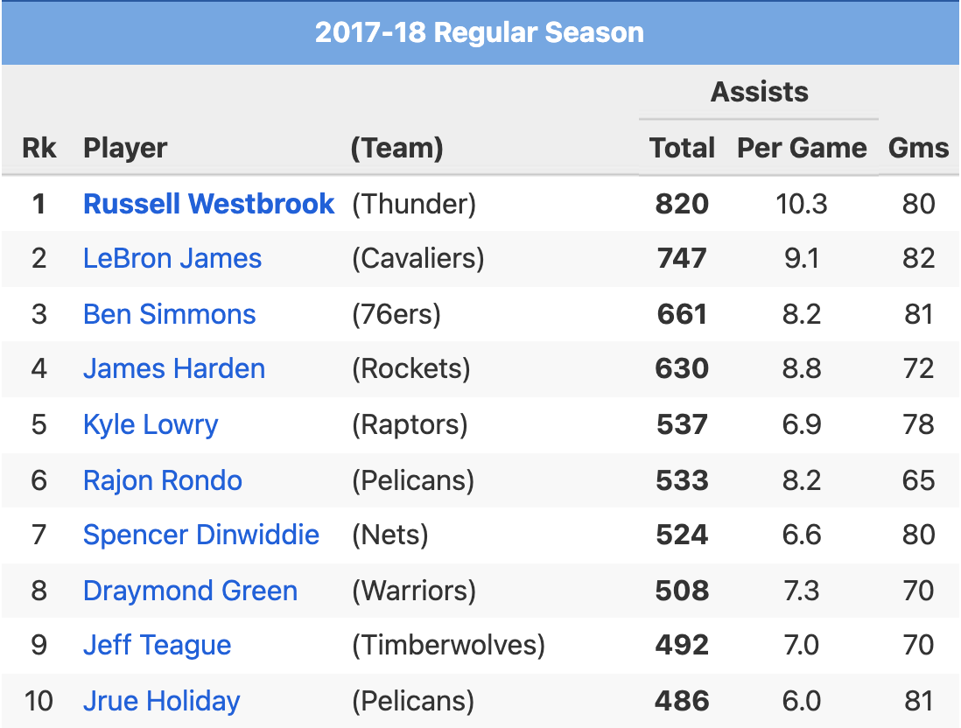
Proportion of Team
Assists Initiated
Style of Player
Common comparable stats
Assists
Assist Percentage (AST%)

Slide 8
With the Graphs...
Winners:
Boston (BOS)
Golden State (GS)
Houston (HOU)
Toronto (TOR)
Losers:
Atlanta (ATL)
Memphis (MEM)
Orlando (ORL)
Phoenix (PHO)

Slide 9
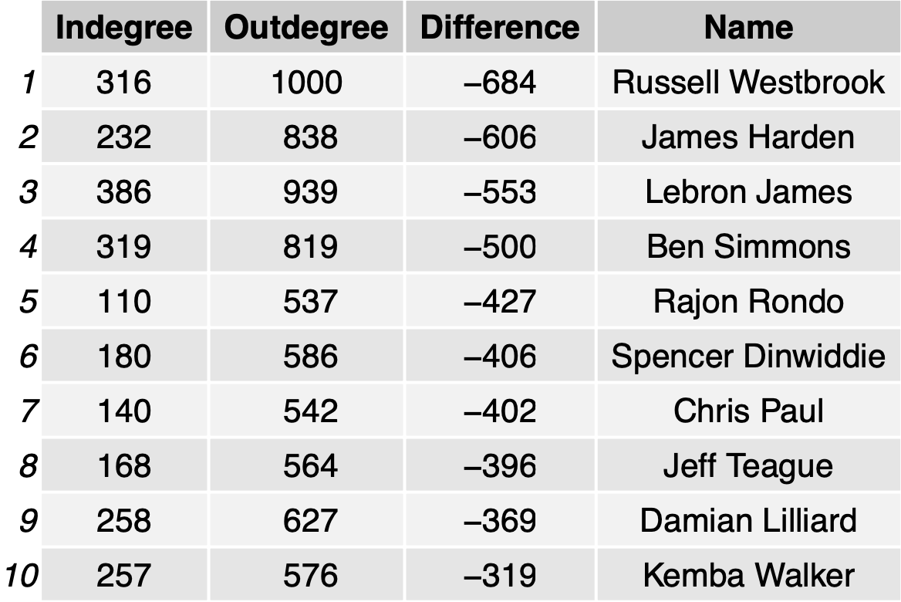
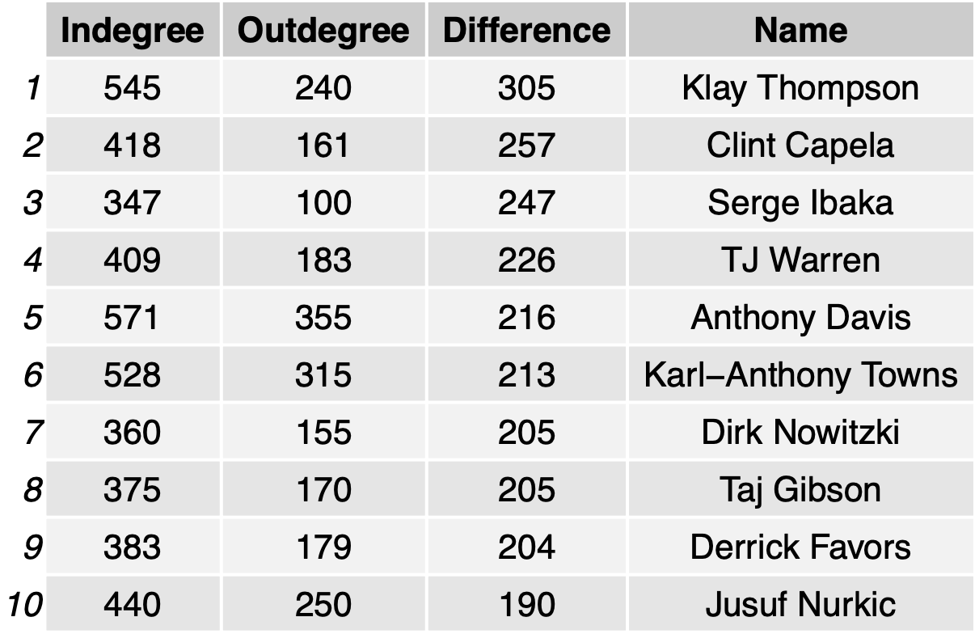
More Patterns of Peformance
Positive difference indicates the player receives more assists than they initiate (negative vice versa)

Slide 10
Questions, thoughts, and comments?

